Slide 1
2024-2032 HOUSING ELEMENT & Fair Housing Analysis Joint PC/CC, AUGUST 27, 2024 4:00 P.M.

Slide 2
What is a Housing Element?
A housing element is a City’s vision and a plan on how best to provide housing for all income groups within the City and affirmatively furthering fair housing.
The housing element must be updated every eight years.

Slide 3
6th CYCLE RHNA ALLOCATION
Jurisdiction | RHNA Allocation | Percent of Total
Avenal | 277 | 3 %
Corcoran | 715 | 8 %
Hanford | 5547 | 59 %
Lemoore | 2329 | 25 %
Unincorporated | 561 | 6 %
TOTAL | 9429 | 100 %

Slide 4
RHNA ALLOCATION
RHNA Allocation by Income Category x Jurisdiction
Jurisdiction | Extremely Low* | Very Low |  | Low |  | Moderate |  | Above Moderate |  | Total
 | Units | Units | % | Units | % | Units | % | Units | % | Units
Avenal | 24 | 48 | 17.3% | 37 | 13.3% | 55 | 20.0% | 137 | 49.4% | 277
Corcoran | 61 | 122 | 17.1% | 116 | 16.3% | 118 | 16.5% | 359 | 50.2% | 715
Hanford | 685 | 1,369 | 24.7% | 993 | 17.9% | 1,066 | 19.2% | 2,119 | 38.2% | 5,547
Lemoore | 293 | 586 | 25.1% | 437 | 18.8% | 408 | 17.5% | 898 | 38.6% | 2,329
Unincorporated | 66 | 132 | 23.5% | 89 | 15.9% | 106 | 18.9% | 234 | 41.8% | 561
County totals | 1,129 | 2,257 | 23.9% | 1,672 | 17.7% | 1,753 | 18.6% | 3,747 | 39.7% | 9,429

Slide 5
What is Fair Housing Analysis?
1. Outreach
2. Assessment of Fair Housing
a. Key Data and Background Information
b. Fair Housing Enforcement and Outreach Capacity
c. Integration and Segregation Patterns and Trends
d. Racially or Ethnically Concentrated Areas of Poverty
e. Disparities in Access to Opportunity
f. Disproportionate Housing Needs in the Jurisdiction
g. Displacement Risk
3. Sites Inventory
4. Identification of Contributing Factors, Goals and Actions

Slide 6
COMMUNITY OUTREACH & TIMELINE
Workshop – Nov. 6, 2023
Public Review Draft – Hearing AUG. 27, 2024
HE Adoption
April 2025

Slide 7
FINDINGS
The Major Findings of the Housing Element Analysis and Fair Housing Analysis are as follows:

Slide 8
DEMOGRAPHIC DATA – Hanford
Total Population: 57,339
Household Population: 56,945
Hispanic or Latino: 44.0%
Households: 18,960
Owner occupied: 48.9%
Persons per HH (Owned): 2.98
Persons per HH (Rented): 3.03
Median HH Income: $65,974 (less than State Median of $78,672)
Poverty: 10.9%
Source: Census, ACS, CA DOF

Slide 9
FAIR HOUSING FINDINGS
1. Diversity (Racial and Ethnic Diversity):
Nearly half of the population, 44%, identifies as Hispanic or Latino. 38.5% identify as White. 7.4% of the population identifies as Asian (compared to Kings County’s 3.6%). Hanford has similar share of Black or African Americans, 5.7%, to Kings County’s share of 5.9%. Hanford has a small percentage of American Indian/Alaska Native, Native Hawaiian/Pacific Islander, and other races.

Slide 10
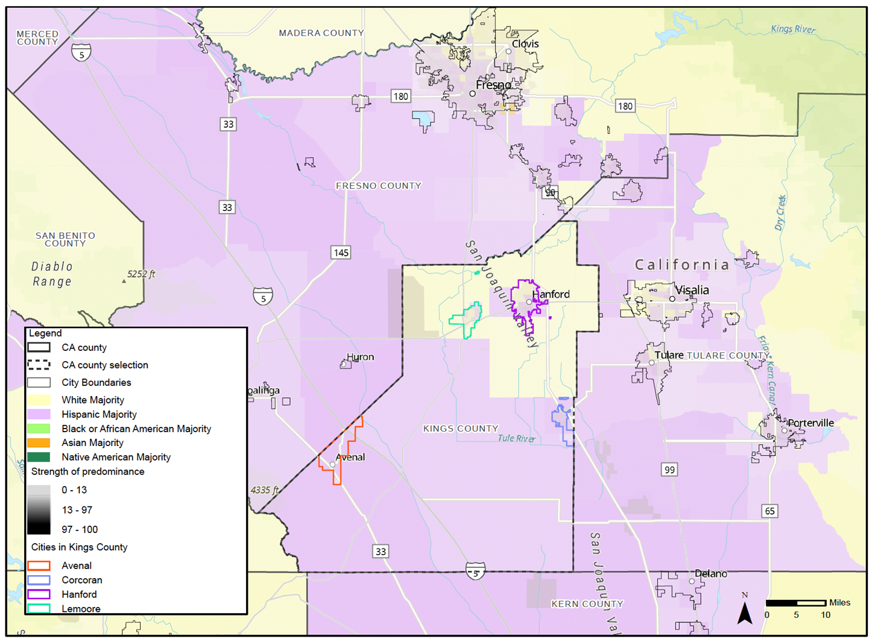
PREDOMINANT RACE Sources: California Department of Housing and Community Development. American Community Survey (ACS), 2017-2021. Updated: March, 2021.

Slide 11
FAIR HOUSING INDICATORS
2. GINI Index (Income Disparity):
The City of Hanford has a Gini index of 0.41, the same as King County. California has an index value of 0.49. This shows that the City has similar levels of inequality as the state and county, though Hanford and Kings County slightly outperform the state overall.

Slide 12
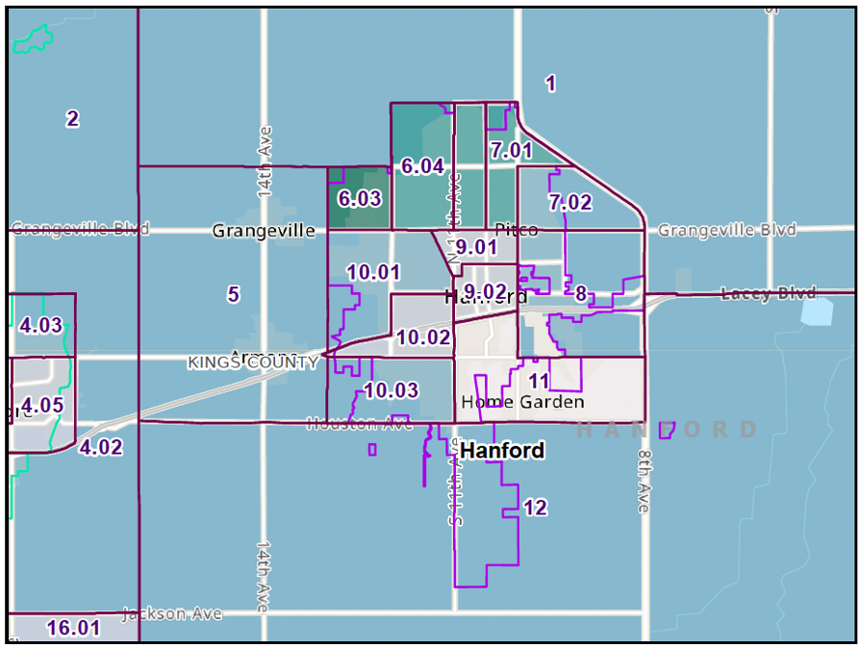
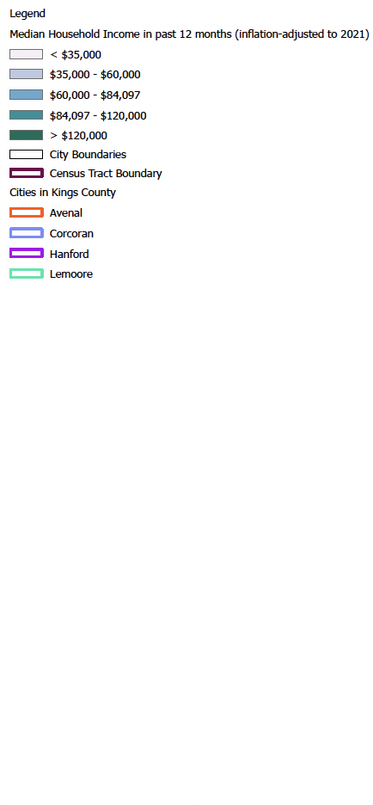
LOCAL MEDIAN INCOME (ACS, 2017-2021) – TRACT Sources: California Department of Housing and Community Development. ACS 5yr estimates (2017-2021). Updated: March, 2023.

Slide 13
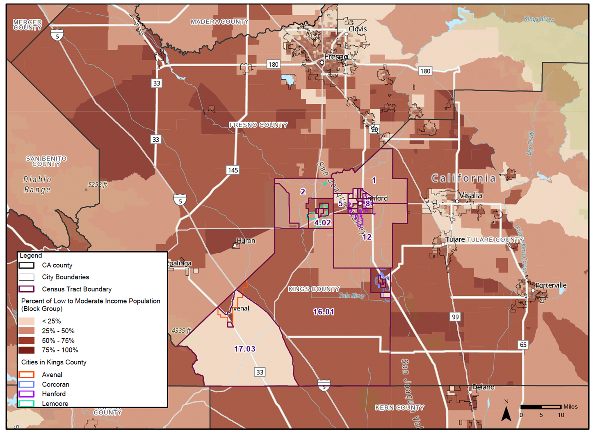
Low to Moderate Income Population - Block Group Level Sources: California Department of Housing and Community Development (HUD), 2011-2015. Updated: March, 2023.

Slide 14
FAIR HOUSING INDICATORS
3. Dissimilarity Index.
Dissimilarity suggests that racial or ethnic groups are more unevenly distributed (for example, they tend to live in different neighborhoods). The northern portions of Hanford have low segregation while southern portions have higher segregation and poverty.

Slide 15
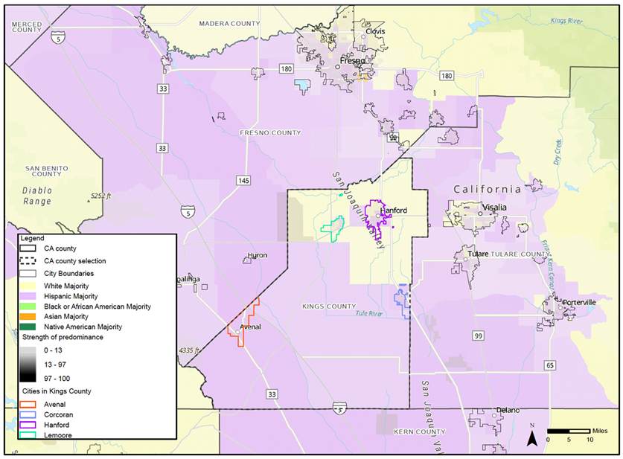
PREDOMINANT RACE Sources: California Department of Housing and Community Development. American Community Survey (ACS), 2017-2021. Updated: March, 2021.

Slide 16
FAIR HOUSING INDICATORS
4. Racially or Ethnically Concentrated area of Poverty (R/ECAP).
The correlation assumes that the lower the income, the higher the diversity of population. Of the 13 census tracts in the City of Hanford, only Census Tract 11 is identified as a R/ECAP.

Slide 17
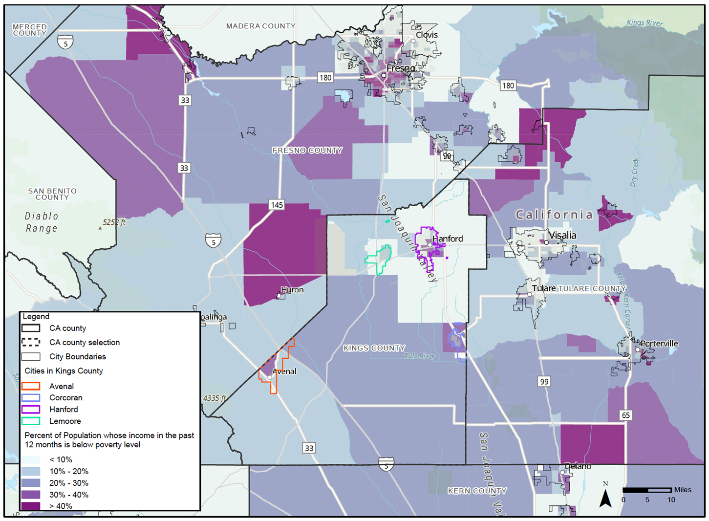
POVERTY STATUS (ACS, 2017-2021) Sources: California Department of Housing and Community Development. American Community Survey (ACS), 2017-2021.

Slide 18
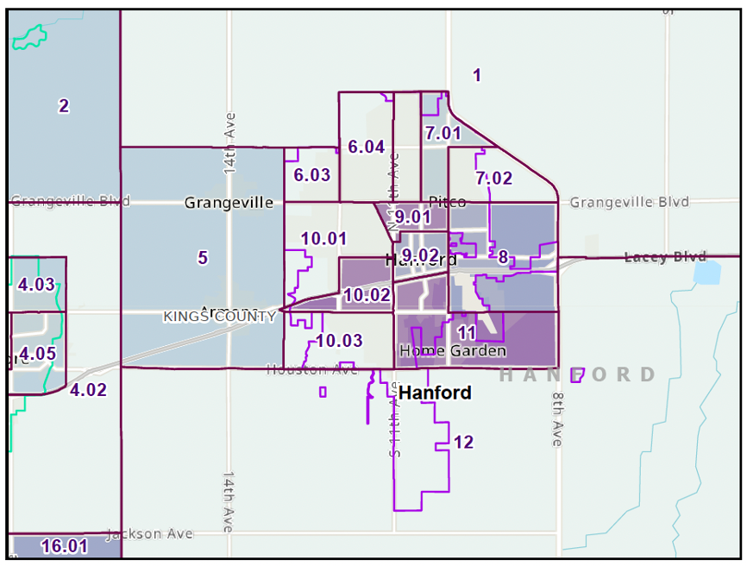
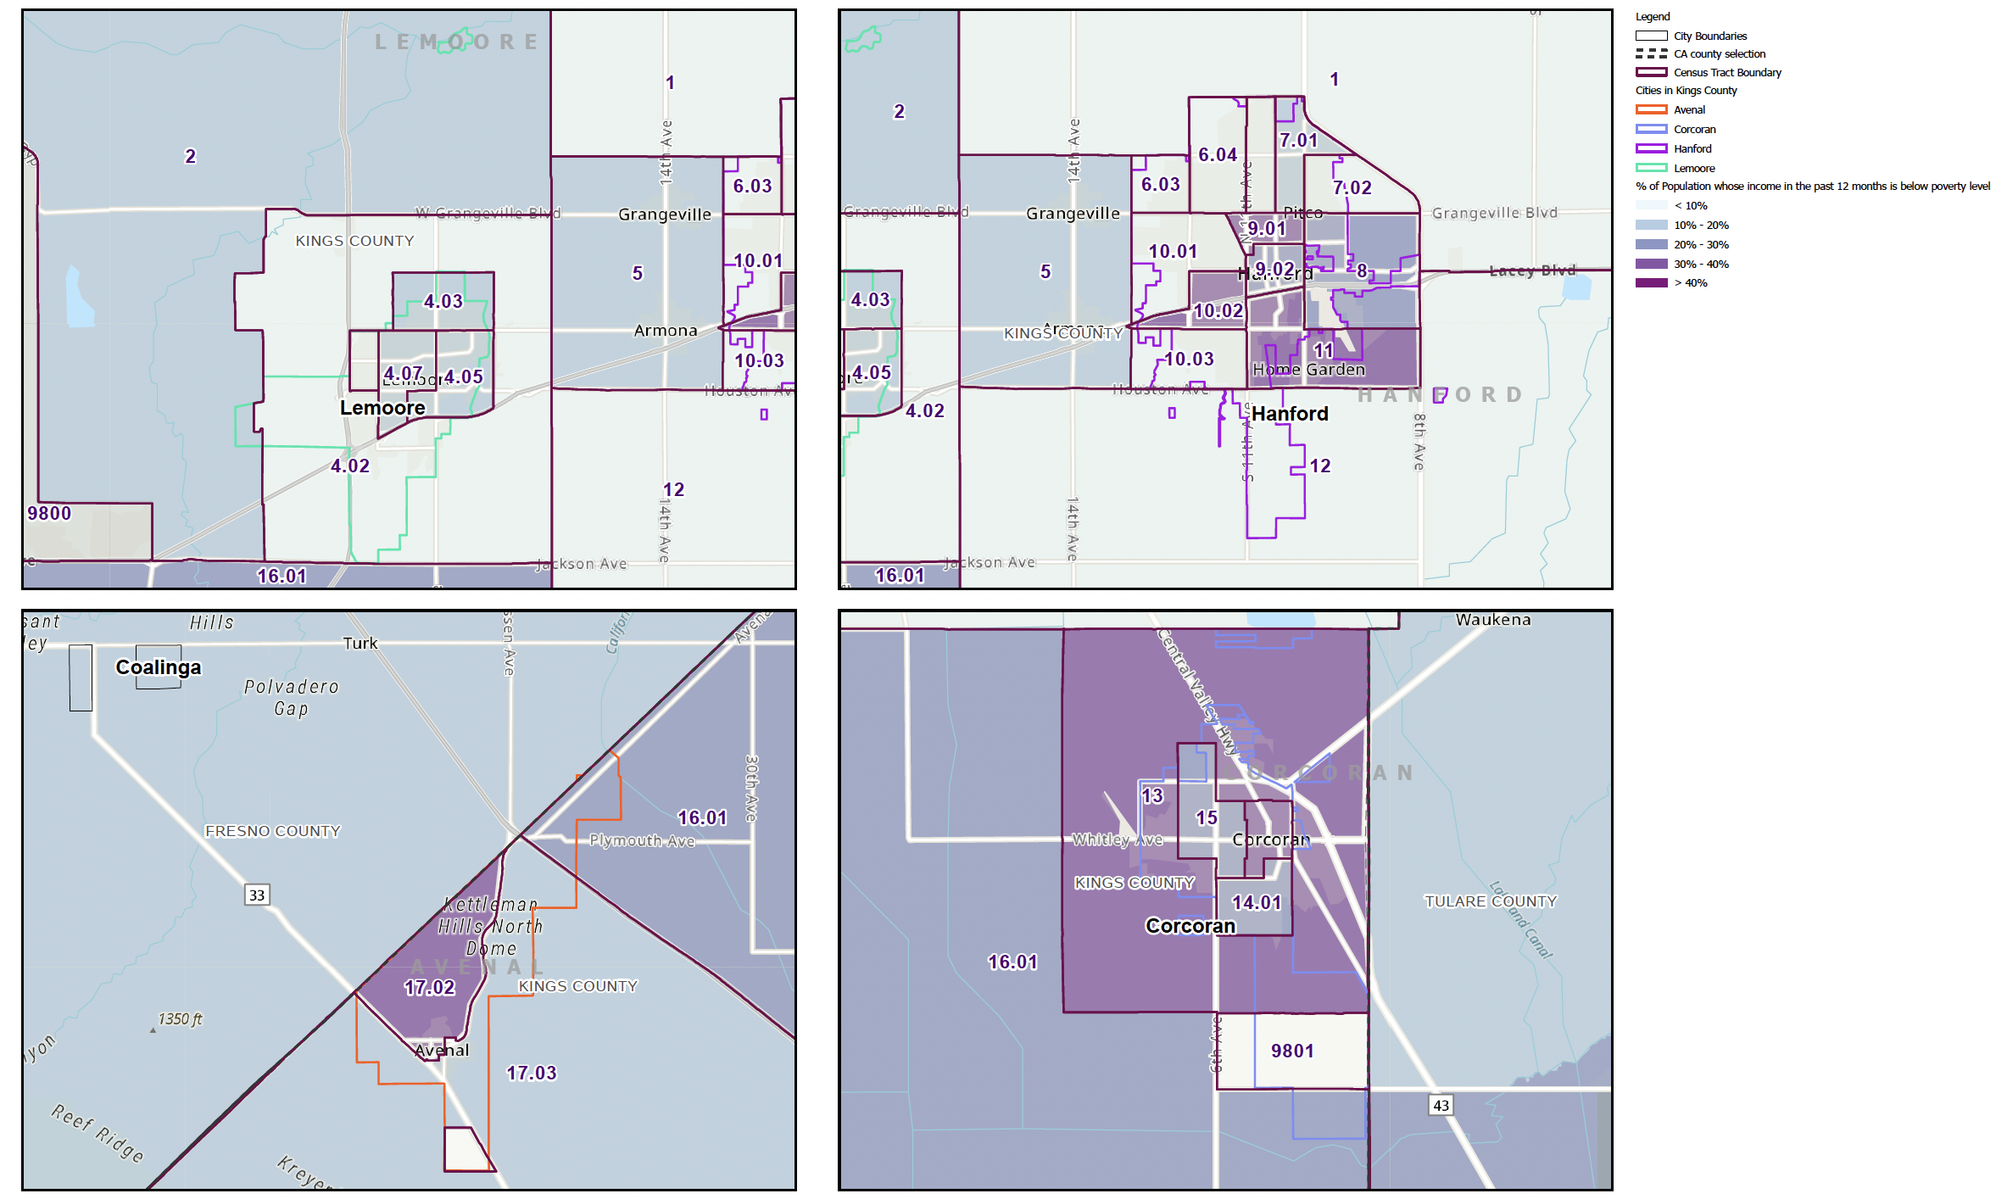
POVERTY STATUS (ACS, 2017-2021) Sources: California Department of Housing and Community Development. American Community Survey (ACS), 2017-2021.

Slide 19
FAIR HOUSING INDICATORS
5. Racially Concentrated Areas of Affluence (RCAA):
Census Tracts 6.03 and 6.04 are identified as RCAAs. The RCAAs generally coincide with TCAC/HCD highest-resource areas.

Slide 20
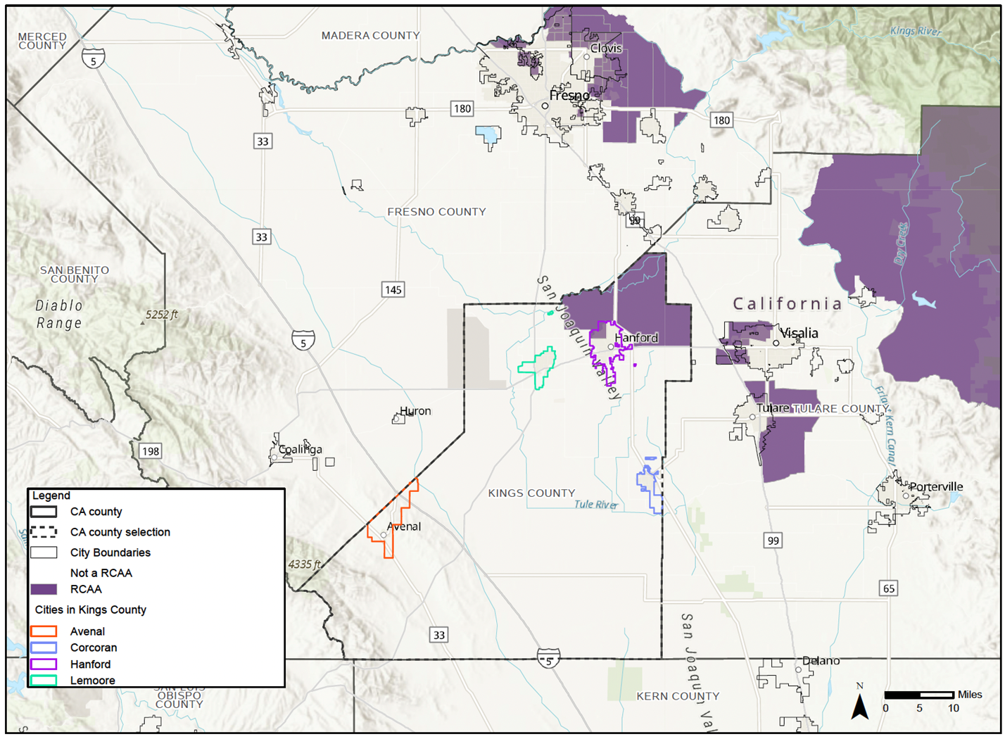
RACIALLY CONCENTRATED AREAS OF AFFLUENCE (RCAA) Sources: American Community Survey (ACS), 2015-2019. Updated: March, 2021.

Slide 21
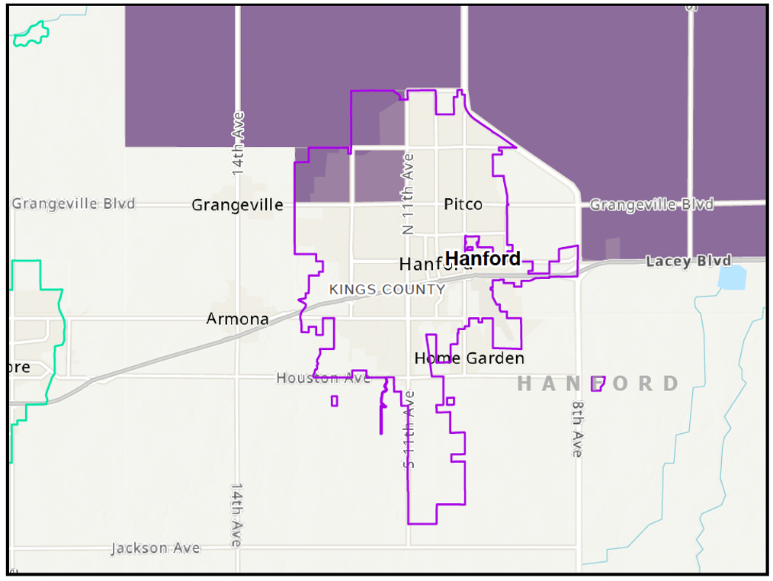
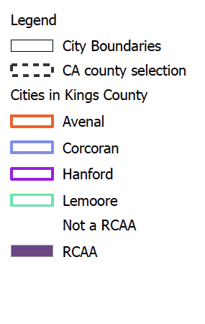
RACIALLY CONCENTRATED AREAS OF AFFLUENCE (RCAA) Sources: American Community Survey (ACS), 2015-2019. Updated: March, 2021.

Slide 22
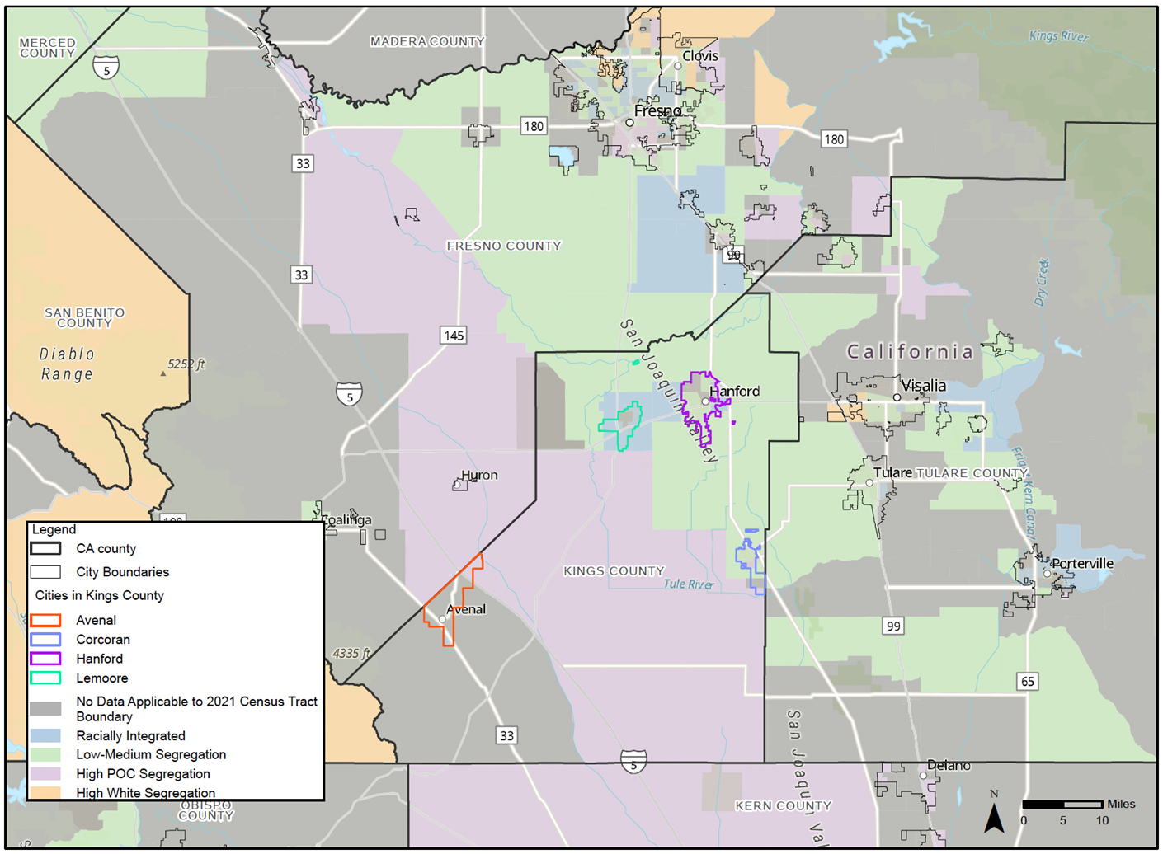
Racially Segregation/Integration Sources: California Department of Housing and Community Development (HUD); OBI, 2020.

Slide 23
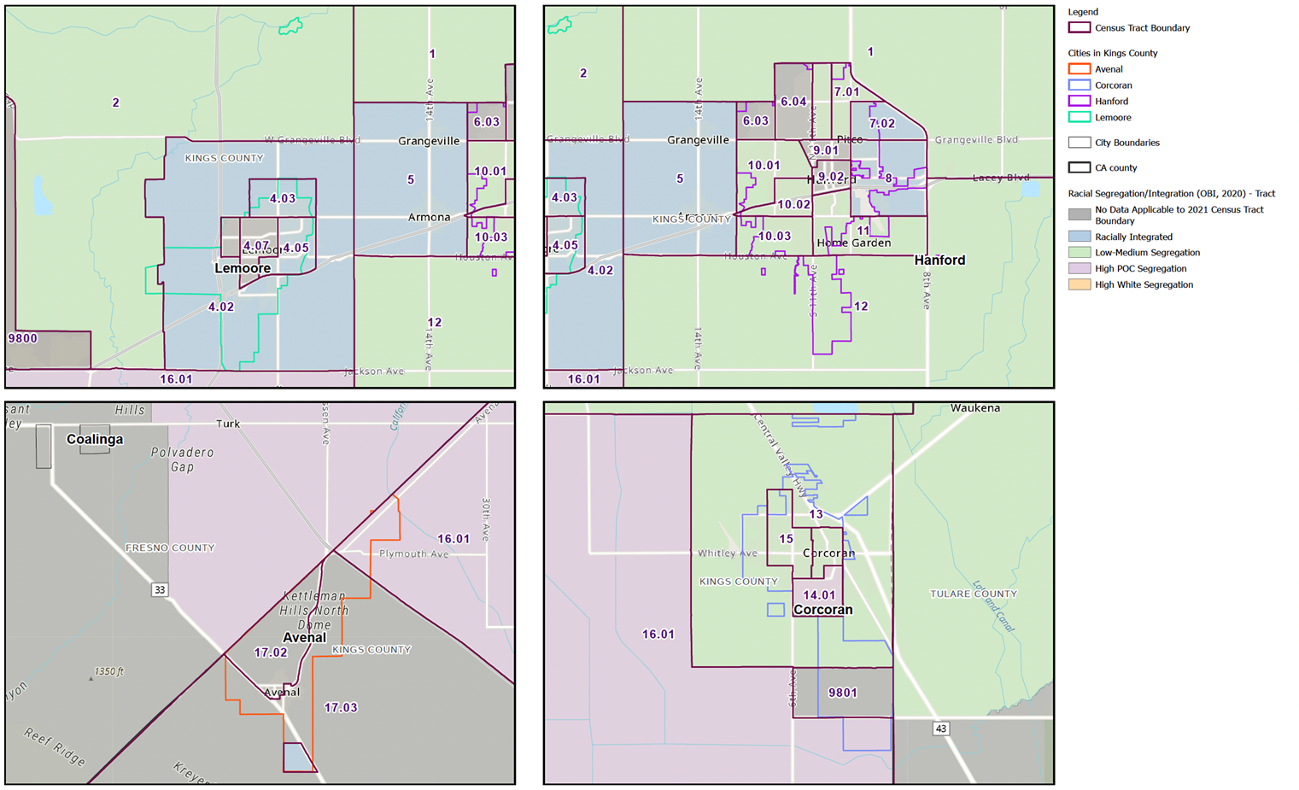
Racially Segregation/Integration Sources: California Department of Housing and Community Development (HUD); OBI, 2020.

Slide 24
FAIR HOUSING INDICATORS
6. Disparities in Access to Opportunities:
Census tracts are categorized as Highest Resource, High Resource, Moderate Resource, Moderate Resource (Rapidly Changing), Low Resource, or areas of High Segregation and Poverty.
The City of Hanford presents a complex socio-economic landscape. The north and northwest portions of the city are designated as Highest Resource and High Resource. The south and southeast portions of the city are designated as Low Resource and some Moderate Resource. Additionally, there is one census tract split by Highway 198 that is designated as High Segregation and Poverty.

Slide 25
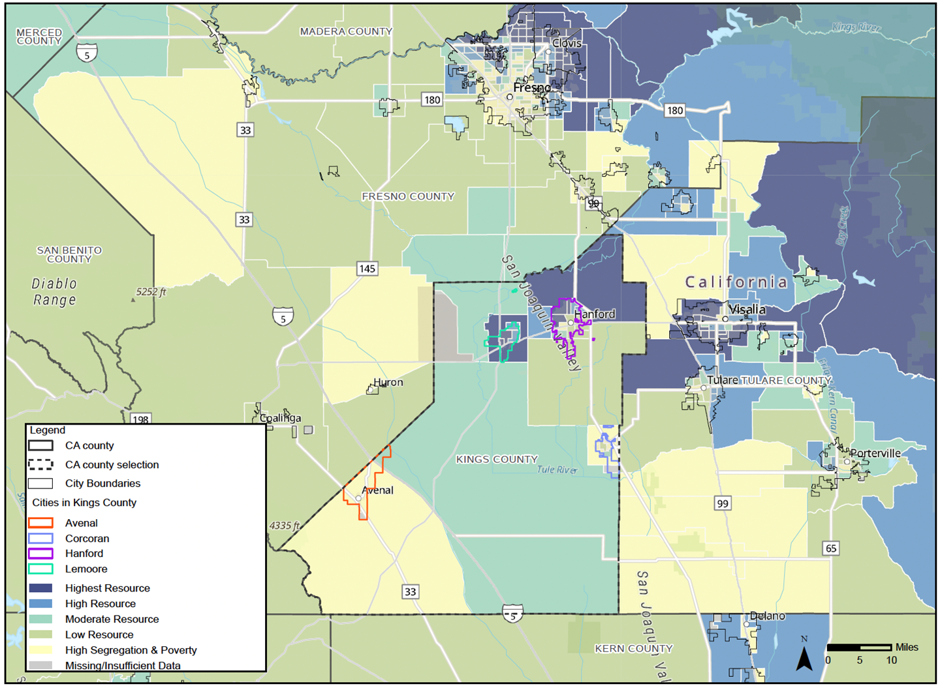
OPPORTUNITY MAP - COMPOSITE SCORE BY TRACT Source: California Department of Housing and Community Development (HCD); California Tax Credit Allocation Committee (TCAC), Updated Jan 2023.

Slide 26
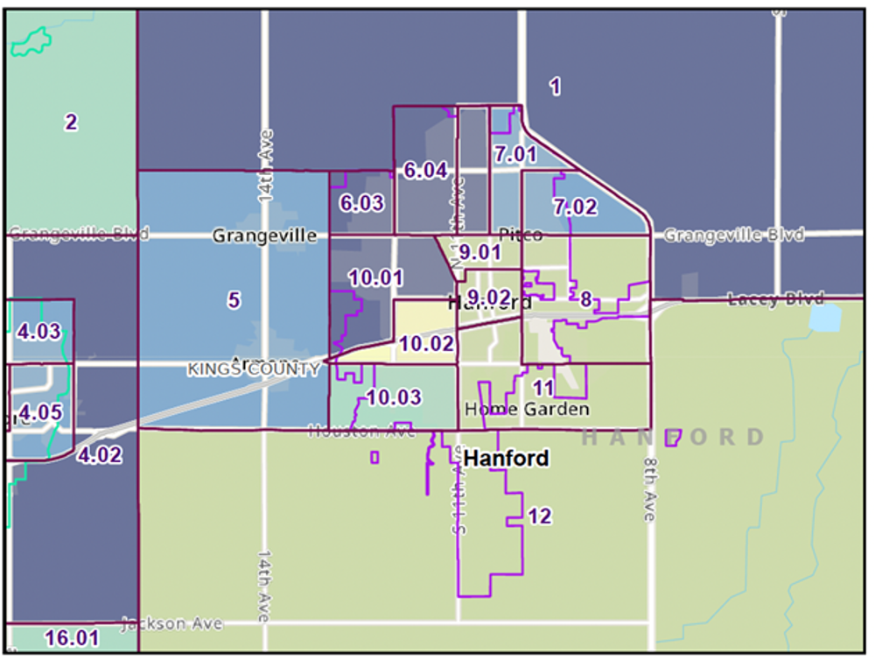
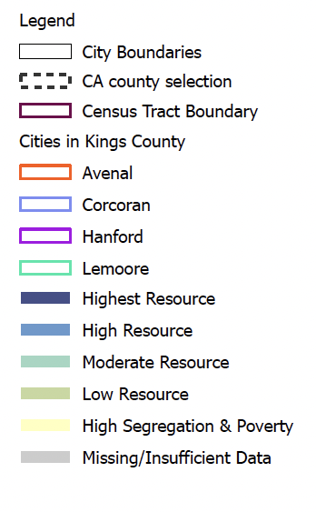
OPPORTUNITY MAP - COMPOSITE SCORE BY TRACT Source: California Department of Housing and Community Development (HCD); California Tax Credit Allocation Committee (TCAC), Updated Jan 2023.

Slide 27
FAIR HOUSING INDICATORS
7. Disproportionate Housing Needs:
Hanford consists of more owners who occupy their own units in comparison to Kings County where about half of homeowners occupied their own unit. In turn, renter-occupied housing units are less common in the City of Hanford compared to Kings County. These conditions, areas with high owner occupancy and low vacancy rates, may see appreciating property values.

Slide 28
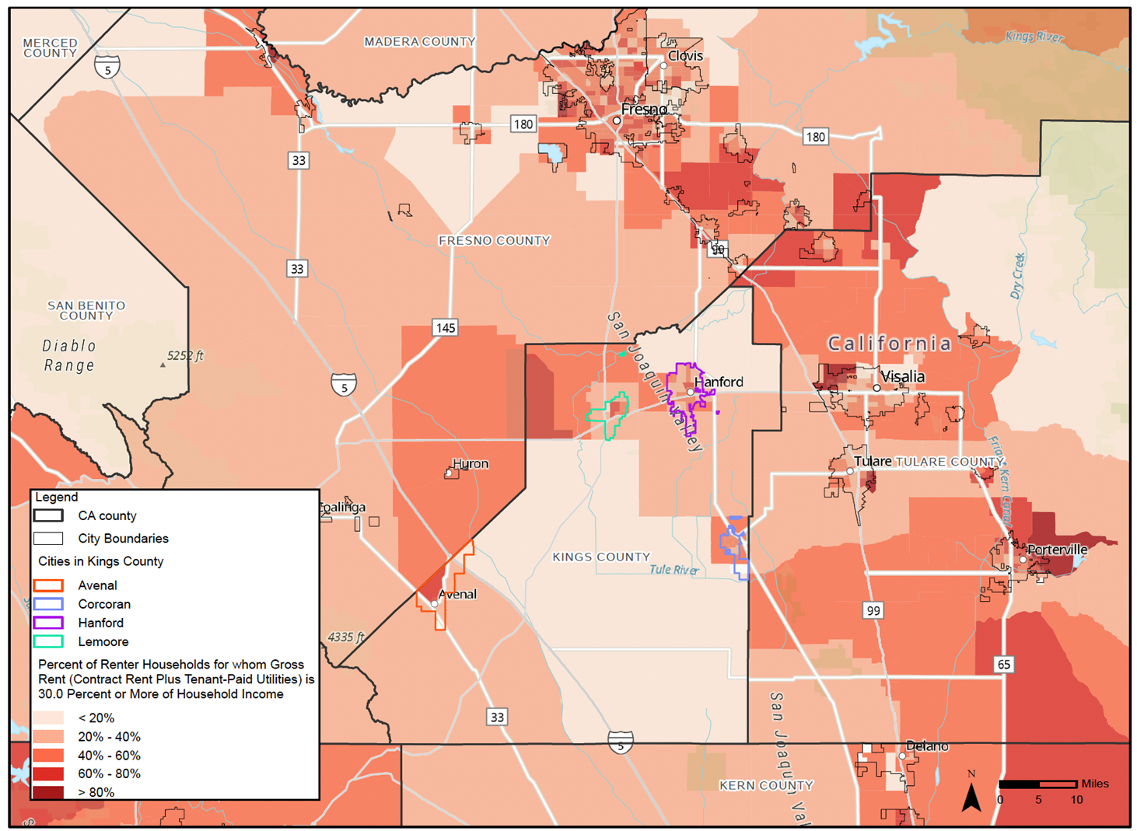
OVERPAYMENT BY RENTERS (ACS, 2017-2021) - TRACT LEVEL Sources: California Department of Housing and Community Development (HUD), ACS, 2017-2021.

Slide 29
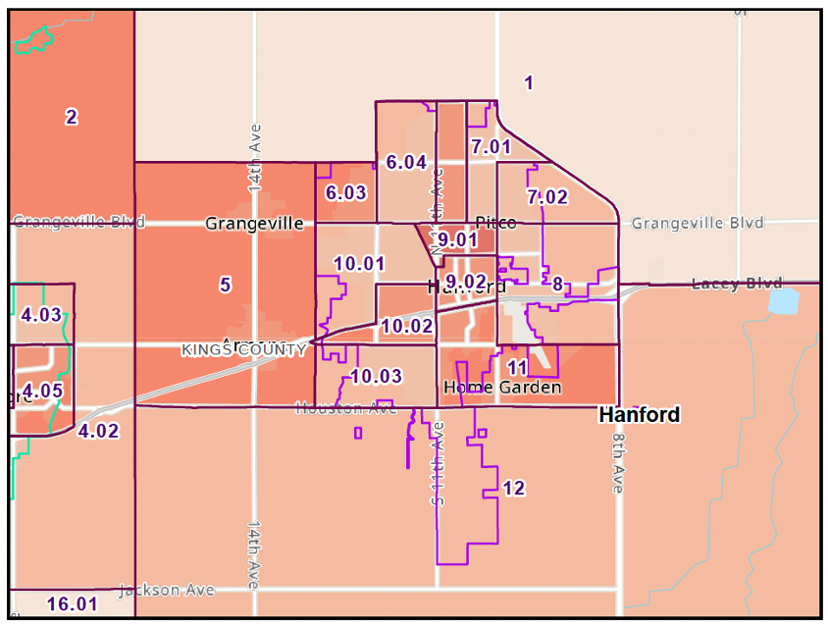
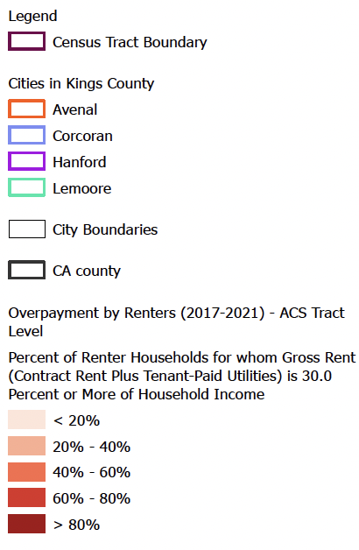
OVERPAYMENT BY RENTERS (ACS, 2017-2021) - TRACT LEVEL Sources: California Department of Housing and Community Development (HUD), ACS, 2017-2021.

Slide 30
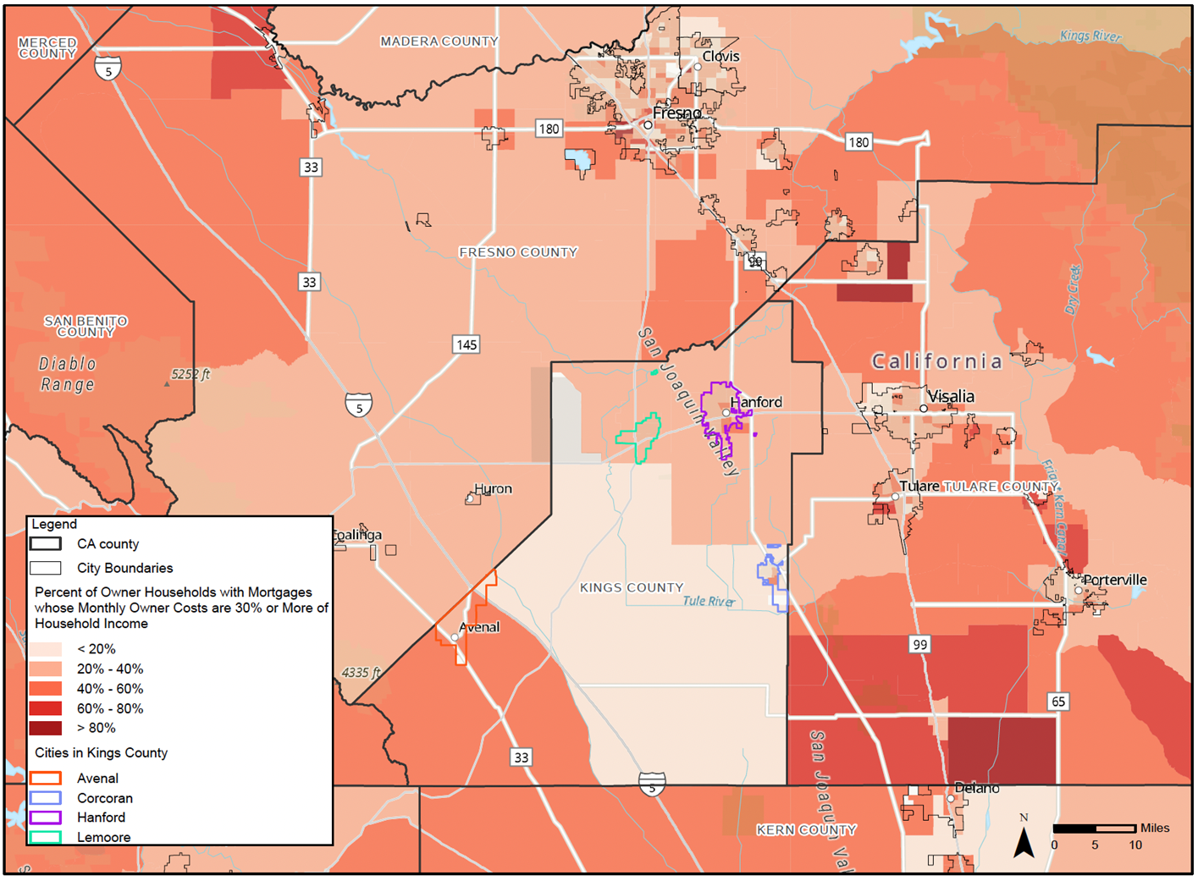
OVERPAYMENT BY HOMEOWNERS (ACS, 2017-2021) – TRACTWISE Sources: California Department of Housing and Community Development (HUD), ACS, 2017-2021.

Slide 31
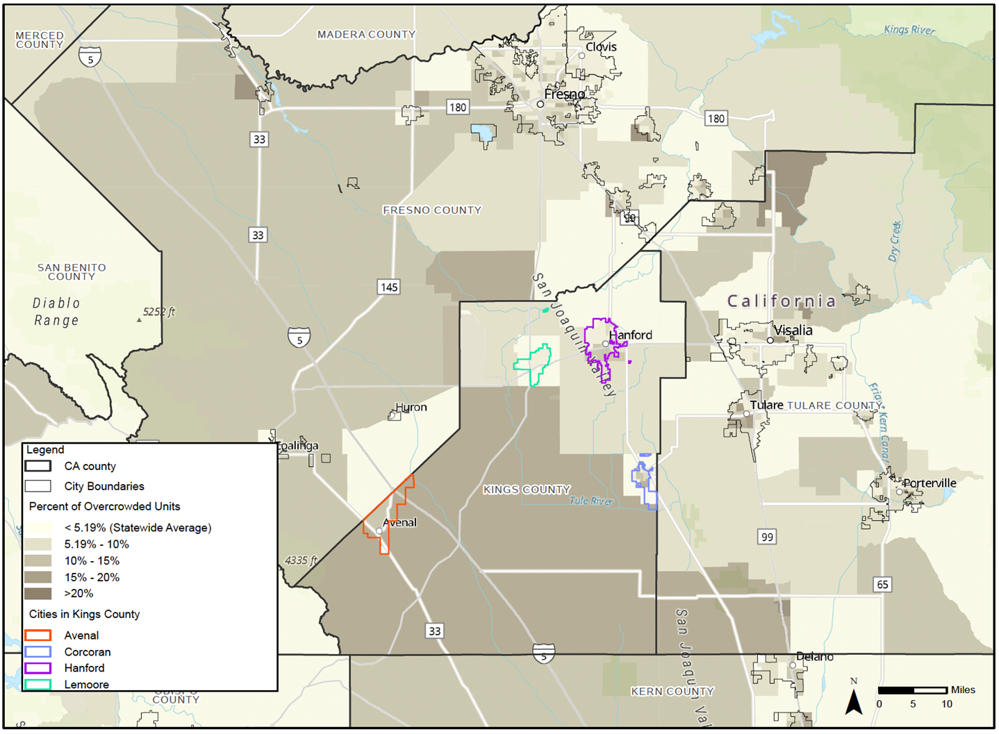
OVERCROWDING BY TRACT Sources: California Department of Housing and Community Development (HUD), ACS, 2017-2021.

Slide 32
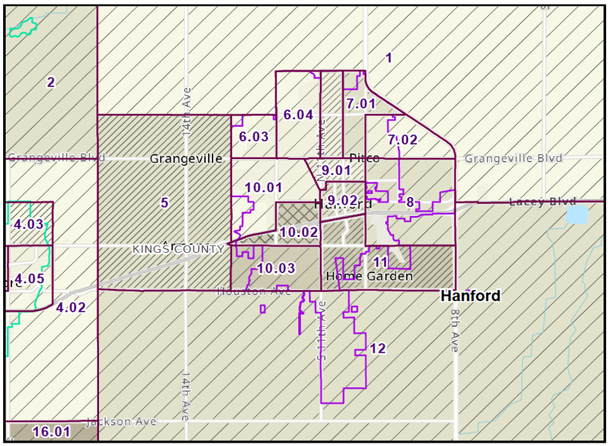
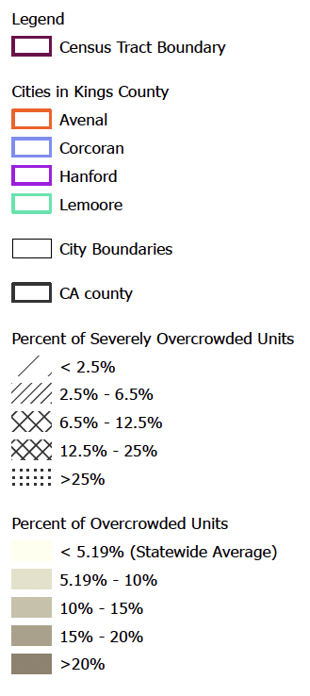
OVERCROWDING BY TRACT Sources: California Department of Housing and Community Development (HUD), ACS, 2017-2021.

Slide 33
FAIR HOUSING INDICATORS
8. Displacement
The City of Hanford is at risk of displacement in the southern and central areas. The rest of city is at lower risk of displacement. Neighboring areas have lower risks of displacement as well. Displacement risk refers to the likelihood of residents, particularly low-income renter households, being forced to move out of their neighborhoods due to various factors. This concept is often evaluated in the context of gentrification, rising housing costs, and changing neighborhood dynamics.

Slide 34
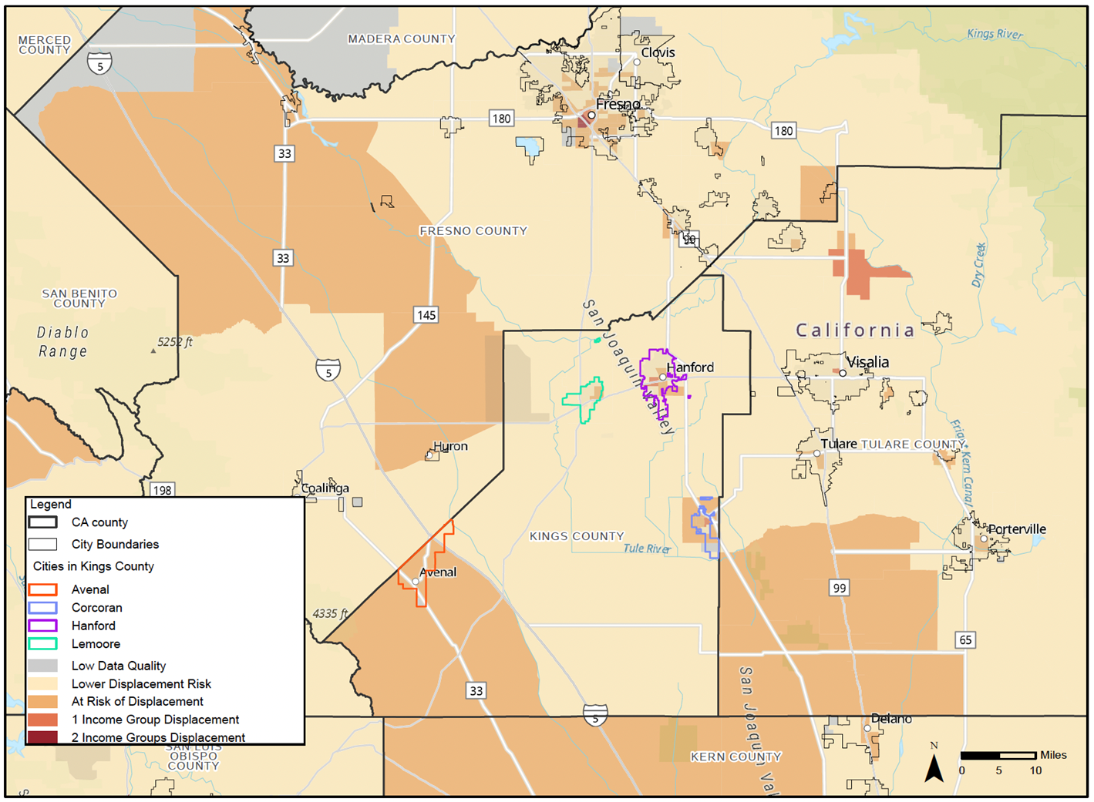
ESTIMATED DISPLACEMENT RISK - OVERALL DISPLACEMENT BY TRACT Sources: California Department of Housing and Community Development (HUD), UCB - Urban Displacement Project, 2022

Slide 35
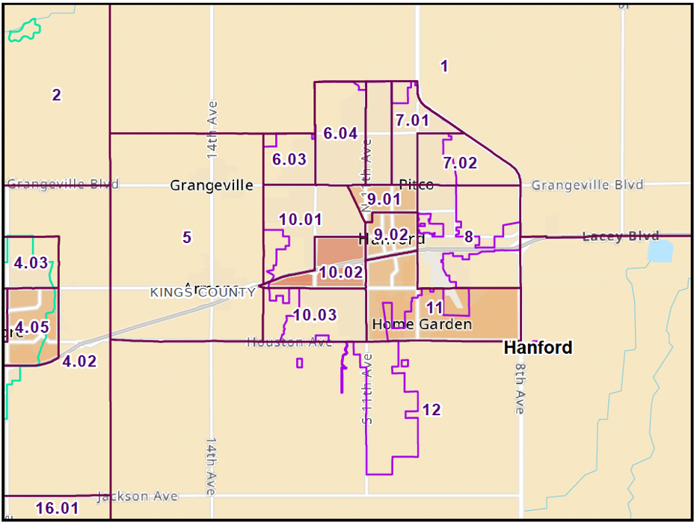
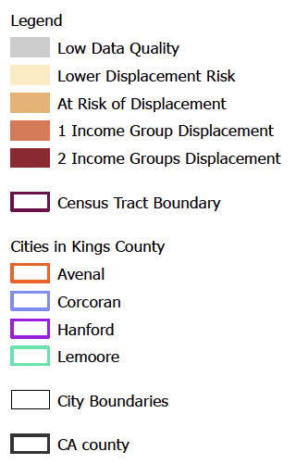
ESTIMATED DISPLACEMENT RISK - OVERALL DISPLACEMENT BY TRACT Sources: California Department of Housing and Community Development (HUD), UCB - Urban Displacement Project, 2022

Slide 36
FAIR HOUSING INDICATORS
9. Site Inventory
The City of Hanford is identified as Racially Integrated on the east and west with Low-Medium Segregation running from north to south. A number of tracts in the north and center lack sufficient data. There is no identified High POC or High White Segregation. Hanford is not in flood hazard or fire hazard severity zones.

Slide 37
FAIR HOUSING INDICATORS
10. Identification of Contributing Factors, Goals and Actions:
The programs contained in in the Housing Element are created in light of the findings of the fair housing analysis and needs of the community.

Slide 38
HOUSING ELEMENT PROGRAM AREAS
County’s housing programs address the following five major areas:
1. Maintaining and preserving the existing affordable housing stock;
2. Assisting in the provision of housing;
3. Removing governmental constraints, as necessary;
4. Providing adequate sites to achieve a variety and diversity of housing; and
5.Promoting equal housing opportunity.

Slide 39
QUANTITATIVE HOUSING OBJECTIVES
Housing/Type | Extremely Low Income | Very Low Income | Low Income | Moderate & Above Moderate Income | Total
RHNA 6th Cycle Allocation | 684 | 685 | 993 | 3,185 | 5,547
New Construction
Rehabilitation
Conservation/Rehabilitation

Slide 40
CEQA
California Environmental Quality Act (CEQA)
Common Sense Exemption, CEQA Guidelines Section 15061(b)(3)).

Slide 41
OPEN PUBLIC MEETING
Open floor for public comments.

Slide 42
Thank you
Please send your comments by mail or email to the CITY OF HANFORD Planning Department.

